Slide 1



MSC3182
SOCIAL ENTREPRENEURSHIP
Lesson 8
BRANDPOSITIONING&
CHANNELS

Slide 2
OVERVIEW OF SALES AND MARKEING
In this lesson, you will be able to
Creating a Positioning Statement,
Branding Strategy,
Company Profile,
Sales Plan, and
Sales Pitch.
Select the right Channels to promote your product/service and
Make a sale.

Slide 3




BRANDS & PRODUCTS
BRANDS
MOBILE PHONE

Slide 4


BRANDING
=

Slide 5

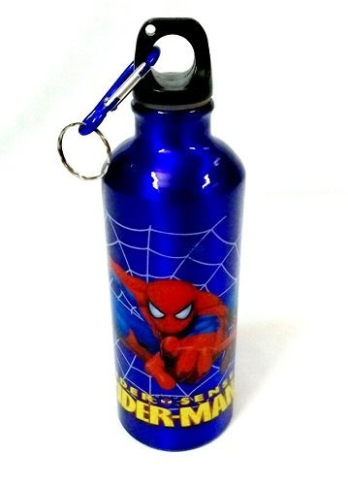



BRANDING
PRODUCTS
BRAND

Slide 6



BRANDING
What is your MENTAL IMAGE of an apple phone?
Word
BRAND
Name
Logo
Because they GETS ATTACHED to the brand over a period of time

Slide 7



BRANDING
with the brand
- the brand builds for itself
It takes TIME and EFFORTS to build a BRAND

Slide 8





BRANDING
EX: BOTTLED WATER
WATER – naturally available resource to all
Although it is FREE, some companies PACK IT IN THE BOTTLE and PUT THEIR BRAND on the bottle
How could companies able to SELL THE PRODUCT which LOOKS AND TASTE THE SAME?
They also claim that their product is BETTER or BEST in the market
Because they create a BRAND

Slide 9














TIPS TO CTREATE A GREAT BRAND

Slide 10
HOW IS A BRAND DIFFERENT FROM A PRODUCT?
Basis for comparison
BRAND
PRODUCT
Uniqueness / Originality
Is Unique
Can be copied
Can it be replaced?
NO
YES
Offers value to customer
Performs the functions
What does it do?
Is it tangible or intangible?
Always intangible
May be tangible or intangible
Brand stays in the heart of the customer
May become outdated, depending on customer's demands
Sustainability
Benefit to customer
Fulfills customer's desires and esteem
Fulfills customer's needs

Slide 11



CONCLUSION

Slide 12

POSITIONING

Slide 13
WHAT IS POSITIONING?
Creating a perception in the minds of the customer about the product and service.
A clear and valued place the product or service occupies in the customer’s mind compared to the competition.
How do businesses express this positioning?
By writting a positioning statement

Slide 14
POSITIONING STATEMENT
A positioning statement is an expression of how a given product, service or brand fills a particular consumer need in a way that its competitors don't.
Positioning is the process of identifying an appropriate market niche for a product (or service or brand) and getting it established in that area.

Slide 15
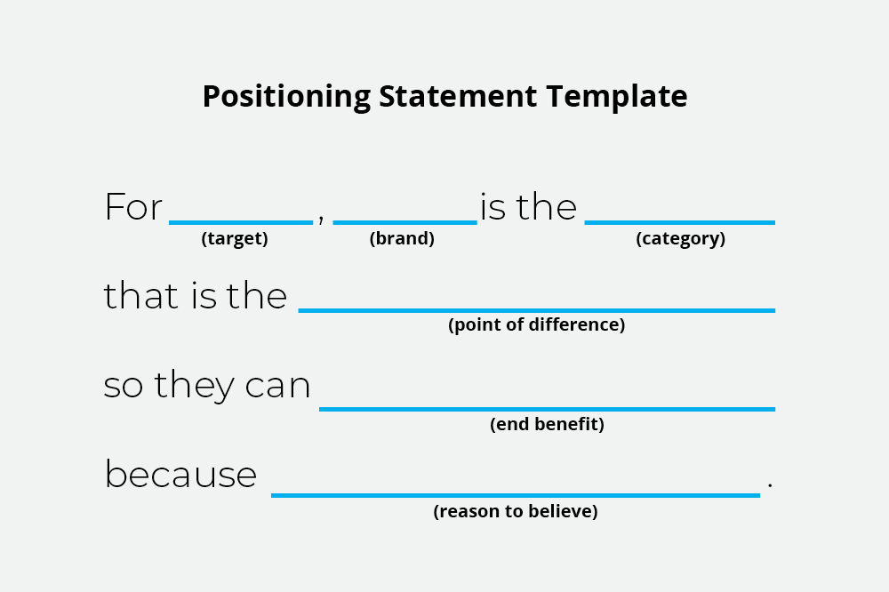
POSITIONING STATEMENT

Slide 16

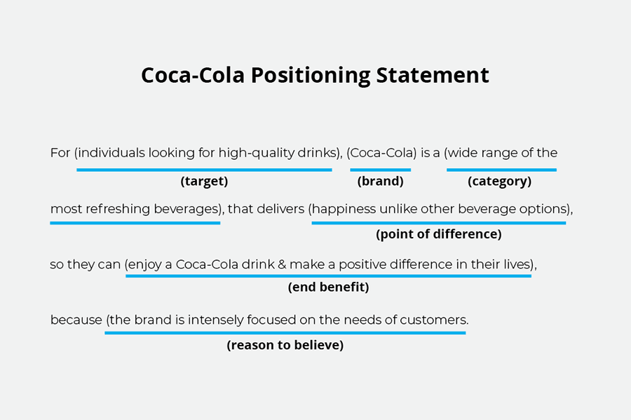
POSITIONING STATEMENT

Slide 17


POSITIONING
Since its launch in NOV 2001 has been a market – they are the TREND SETTERS in terms of Performance, efficiency , styling and all above MACHO felling

Slide 18

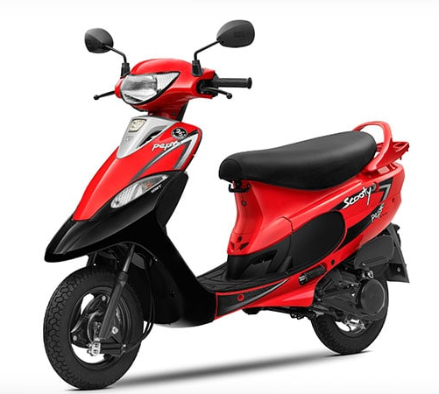
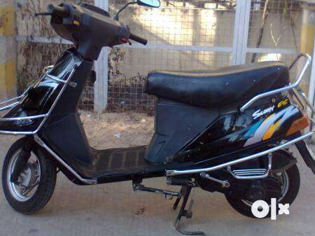
POSITIONING
It was launched in 1993, initially as a unisex two wheeler.
But later it was repositioned to target only women.
The women’s two-wheeler category is a niche one.
Even today, the market penetration is just about 4% nationally.

Slide 19

CHANNELS

Slide 20
INTRODUCTION TO CHANNELING
CHANNELS are the WAYS that GOODS AND SERVICES are MADE AVAILABLE for use by the CUSTOMERS.
EXAMPLES
LOCAL SUPER MARKETS
FLIPKART
AMAZON, ETC

Slide 21



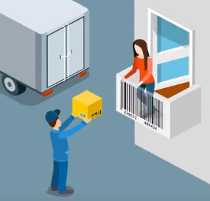
CHANNELS
CHANNELS are for communicating with our CUSTOMERS

Slide 22


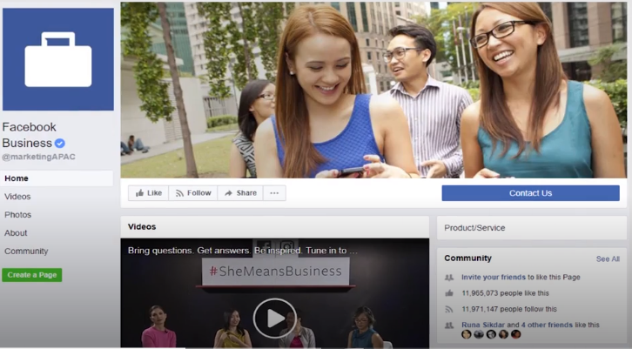



CHANNELS - Communicating with our customers
EXAMPLE

Slide 23

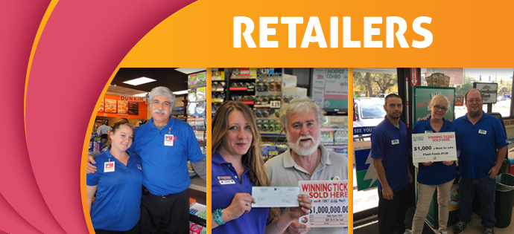



CHANNELS - Delivery
EXAMPLES

Slide 24



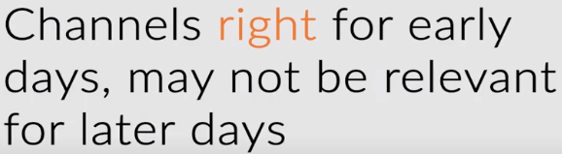

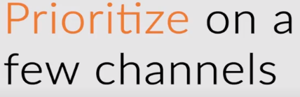
TIPS TO GET STARTED WITH CHANNELS
FB page, don’t cost us, but an ADD in the newspaper
Distributing flyers can not work for covering more customers
Do not try to be every where

Slide 25

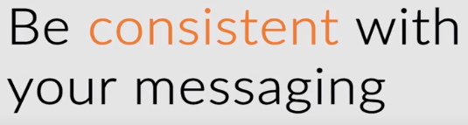
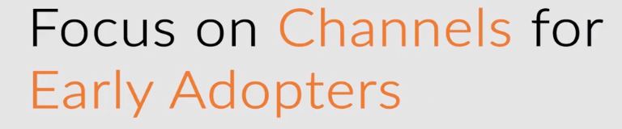
TIPS TO GET STARTED WITH CHANNELS
IN AN EARLY STAGE

